Slide 1
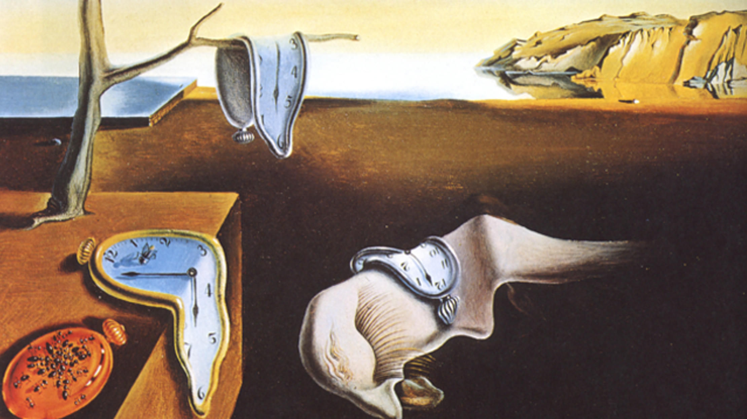

Biodiversity patterns across space and time
Federico Riva, PhD
McGill, BIOL 310-XXX February 9th, 2022
federicoriva@cunet.carleton.ca https://github.com/FedericoRiva @riva_ecology

Slide 2
Today, my goal is convincing you that the spatial and temporal scales of your analysis are crucial to interpreting your findings

Slide 3
Spatial scale
Space
Temporal scale
Time
Resolution

Slide 4
Summary
The complexity of natural systems
Scaling in ecology and conservation
History of research on scales
Theory developed to understand biodiversity across scales
The role of scaling in solving long-standing debates
Implications for applied conservation
Conclusions
Some suggestions on how to deal with it in your work
R workshop

Slide 5
Complexity in ecology

Slide 6





Slide 7
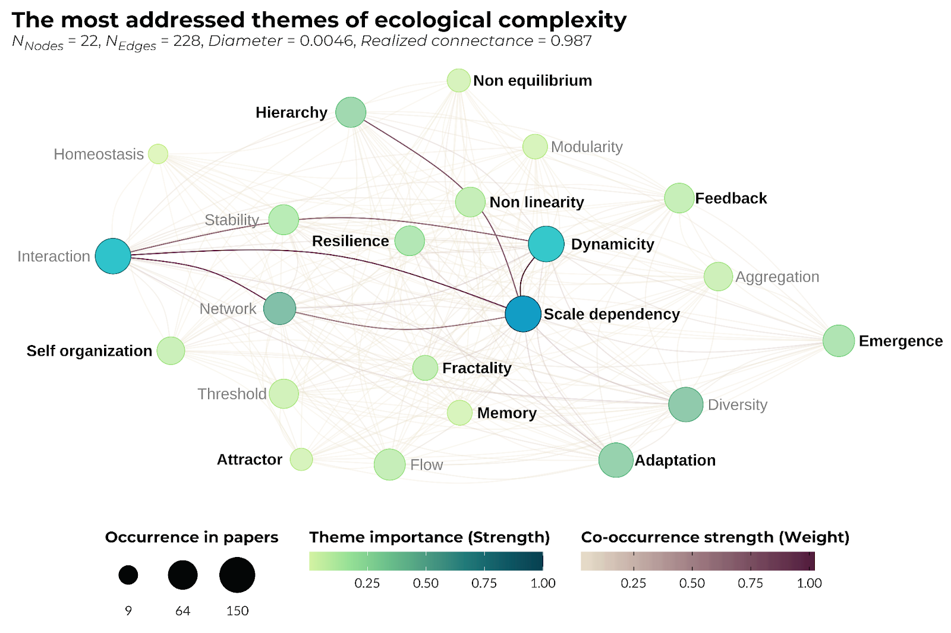
Natural systems are prototypical complex adaptive systems
Riva*, Graco-Roza*, Daskalova, Hudgins, Lewthwaite, Newman, Ryo, Mammola (in prep)

Slide 8
Natural systems are prototypical complex adaptive systems
Riva*, Graco-Roza*, Daskalova, Hudgins, Lewthwaite, Newman, Ryo, Mammola (in prep)

Slide 9
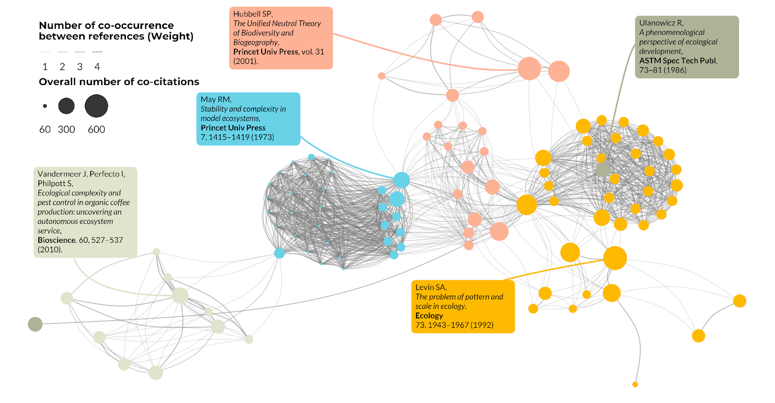
How do we deal with this complexity?
Riva*, Graco-Roza*, Daskalova, Hudgins, Lewthwaite, Newman, Ryo, Mammola (in prep)

Slide 10
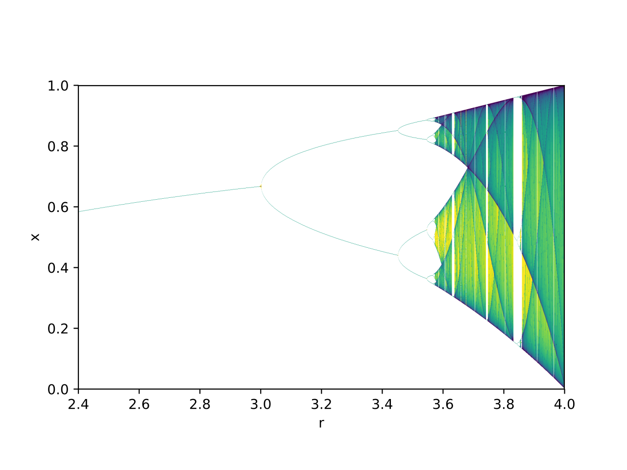
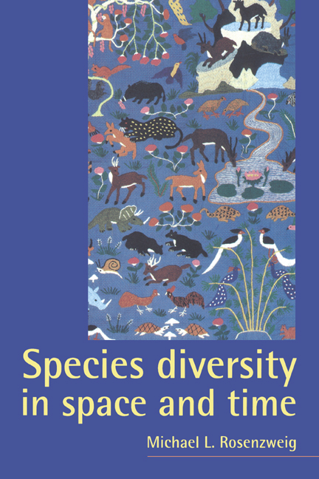
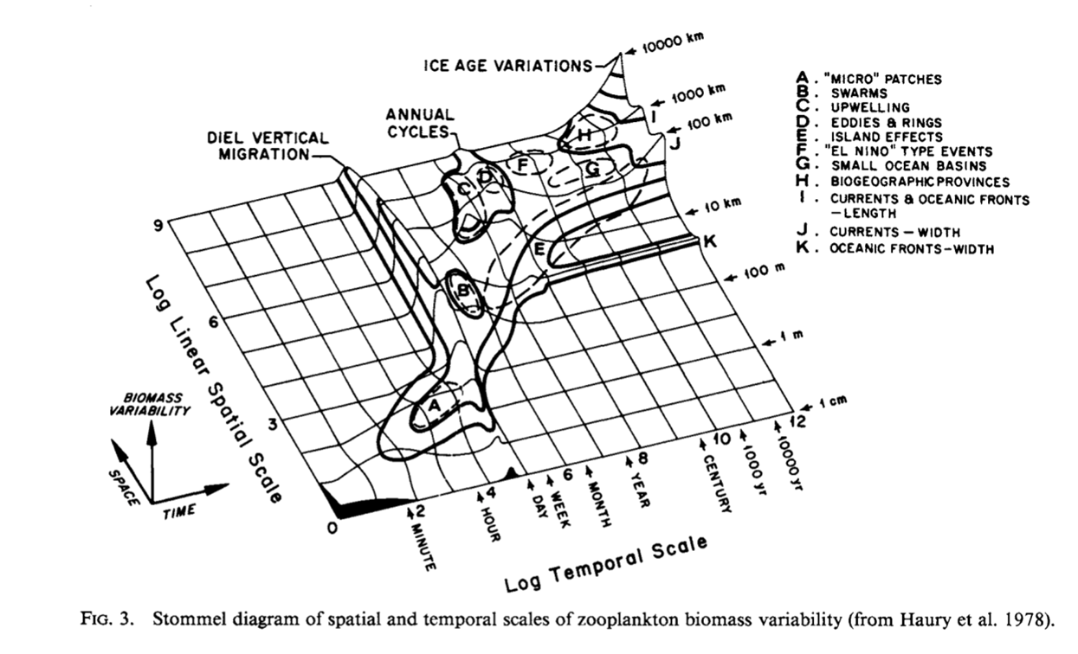
Hard theory Macroecology Scaling
May 1976 Rosenzweig 1995 Levin 1992

Slide 11
By reducing the focus to manageable scenarios, scaling simplifies the complexity of natural systems that otherwise span multiple, interconnected levels of biological organization and change dynamically through time

Slide 12
Growing awareness of the importance of scales

Slide 13
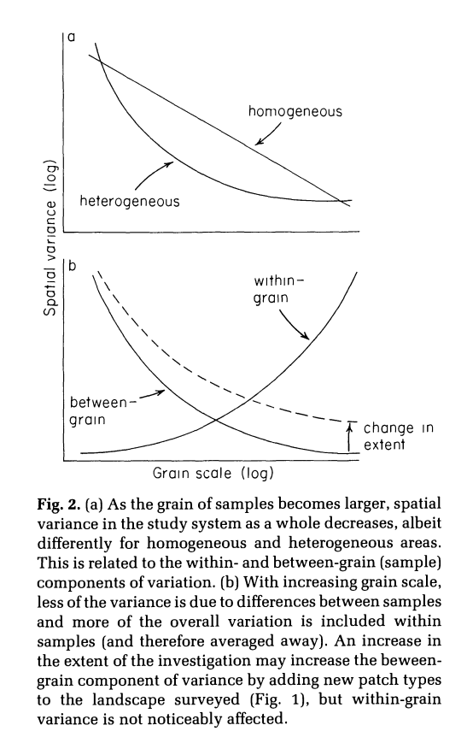
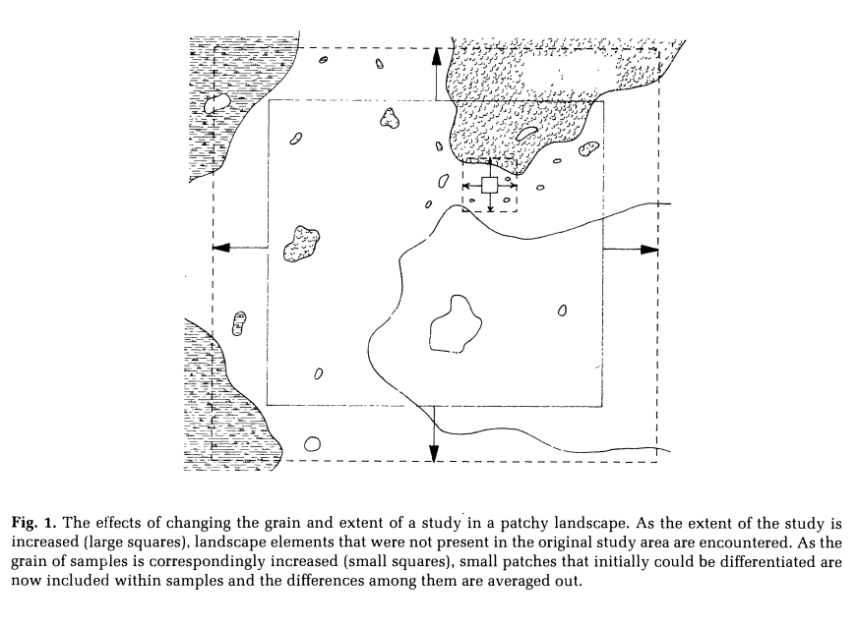
Wiens 1989 – Space
Grain vs. extent
https://esajournals.onlinelibrary.wiley.com/doi/pdfdirect/10.2307/1941447

Slide 14
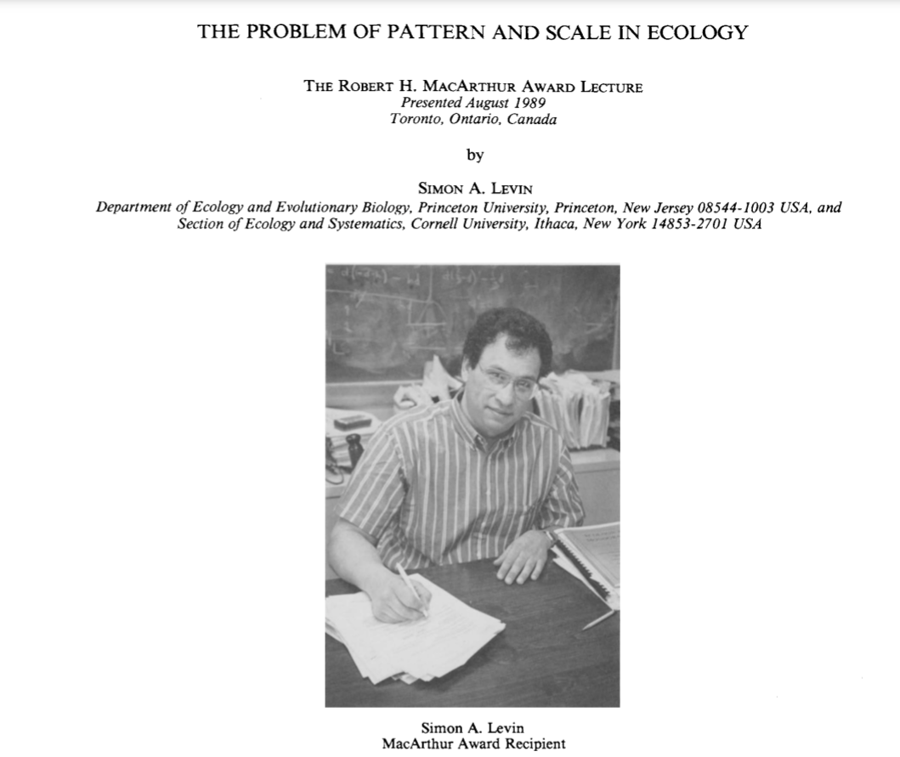
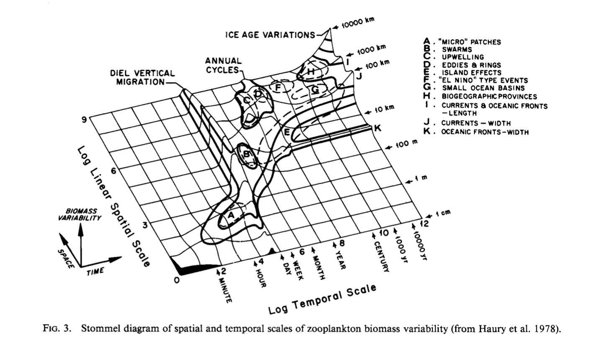
Levin 1992 – Space and time
https://esajournals.onlinelibrary.wiley.com/doi/pdfdirect/10.2307/1941447

Slide 15
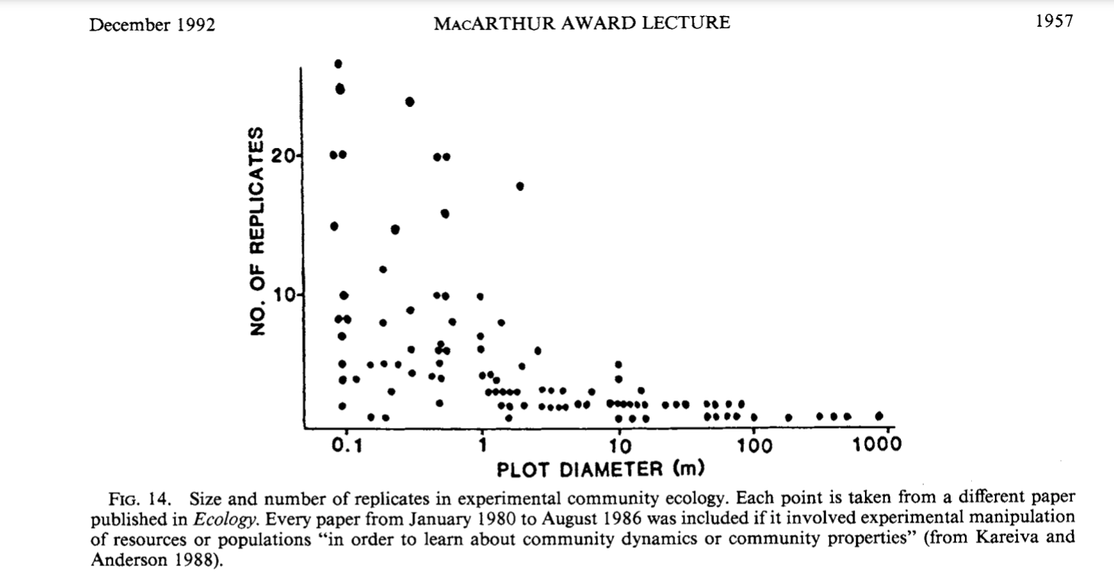
Levin 1992 – Space and time
https://esajournals.onlinelibrary.wiley.com/doi/pdfdirect/10.2307/1941447

Slide 16
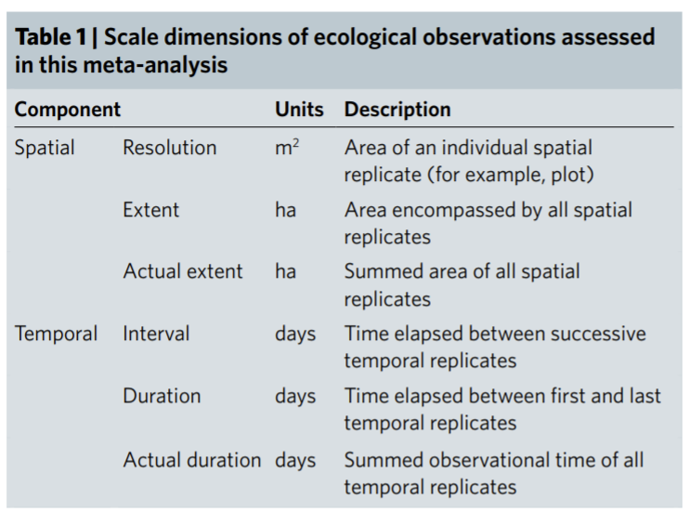
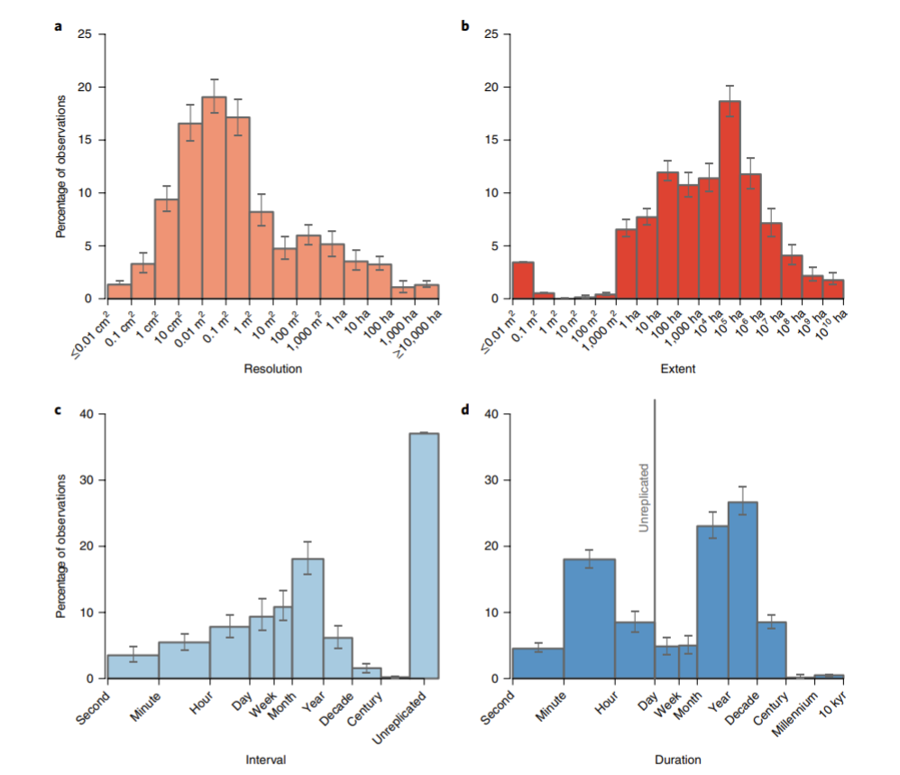
Estes et al. (2018) – after 30+ years, our perspective is still very biased
towards short studies, small spatial resolutions
https://www.nature.com/articles/s41559-018-0524-4

Slide 17
Estes et al. (2018) – after 30+ years, our perspective is still very biased
towards short studies, small spatial resolutions
https://www.nature.com/articles/s41559-018-0524-4

Slide 18
Theoretical paradigms that incorporate scaling in the study of biodiversity

Slide 19
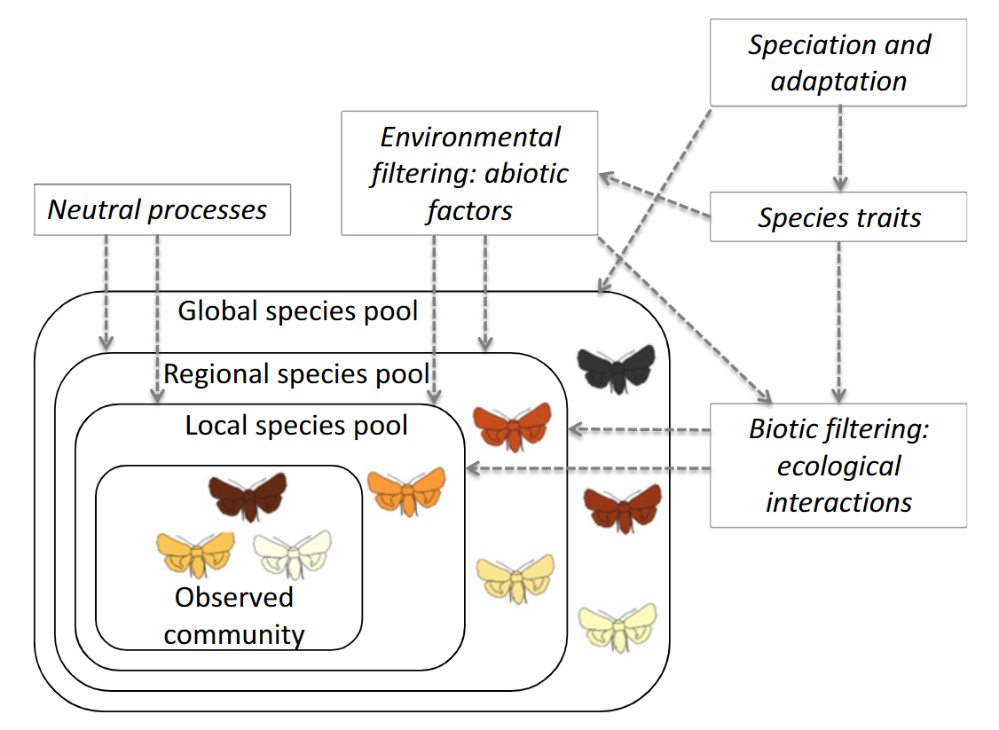
Environmental filtering
Ovaskainen et al. (2017) https://onlinelibrary.wiley.com/doi/10.1111/ele.12757
Kraft et al. (2015) https://besjournals.onlinelibrary.wiley.com/doi/10.1111/1365-2435.12345

Slide 20
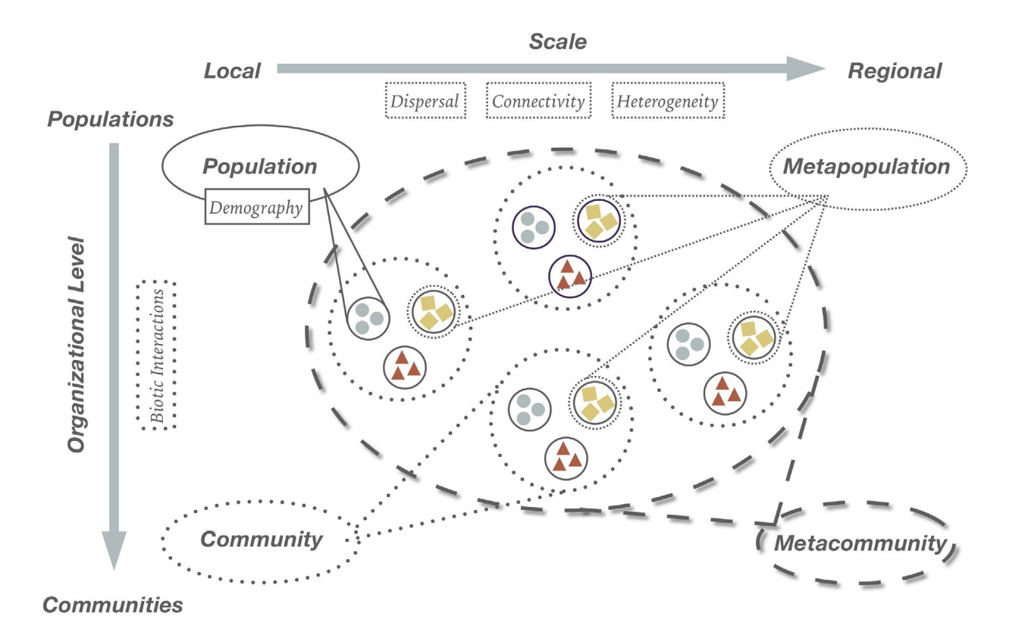
Metacommunity theory
Leibold et al. (2004) https://onlinelibrary.wiley.com/doi/abs/10.1111/j.1461-0248.2004.00608.x
Chase et al. (2020) https://nyaspubs.onlinelibrary.wiley.com/doi/10.1111/nyas.14378

Slide 21
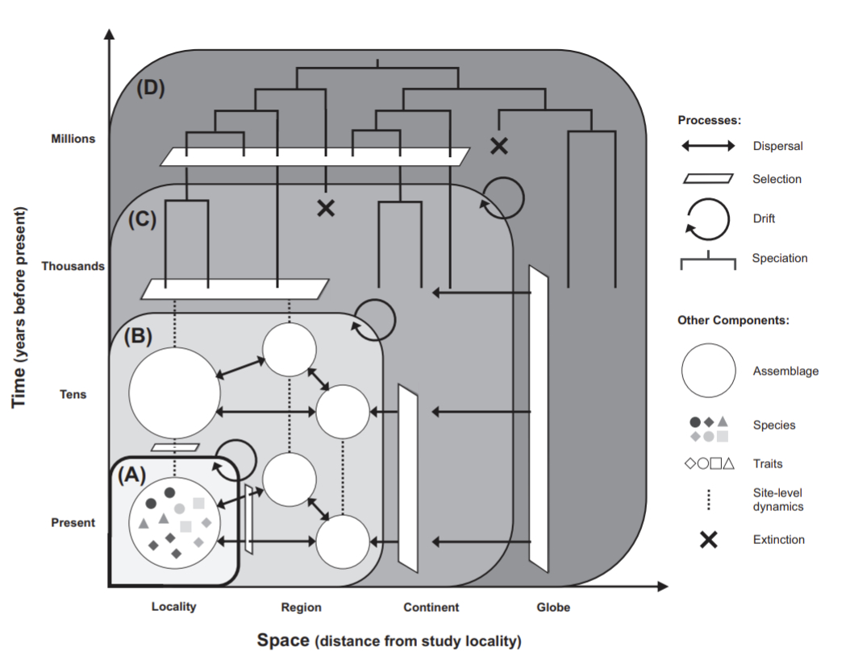
The Theory of Ecological Communities
Vellend (2010) https://www.researchgate.net/publication/44689600_Conceptual_Synthesis_in_Community_Ecology
Rapacciuolo and Blois (2019) https://onlinelibrary.wiley.com/doi/pdf/10.1111/ecog.04616

Slide 22
More or less explicitly, most theoretical paradigms developed to address biodiversity patterns have to tackle the concept of spatial and temporal scales

Slide 23
Yes, but

Slide 24
The concept of ecological community
N species
at a site s,
at time t

Slide 25
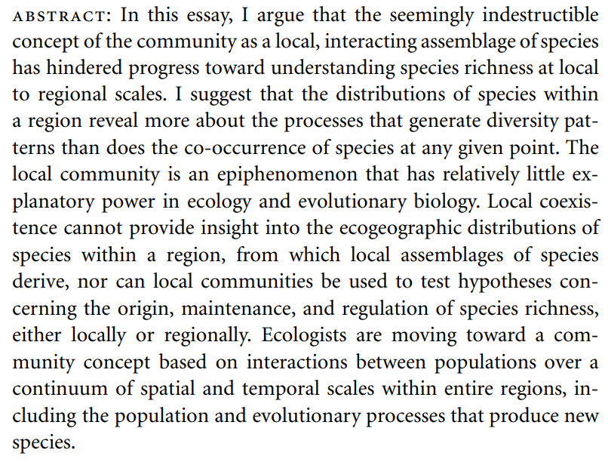
Disintegration of the ecological community
Ricklefs (2008) https://www.zoology.ubc.ca/bdg/pdfs_bdg/2020spring/Ricklefs_2008.pdf

Slide 26
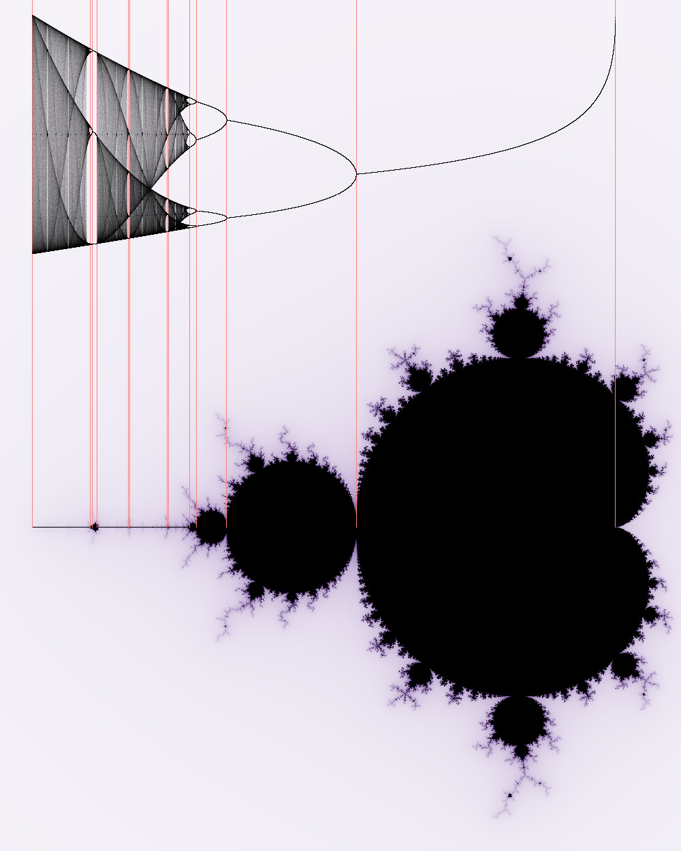
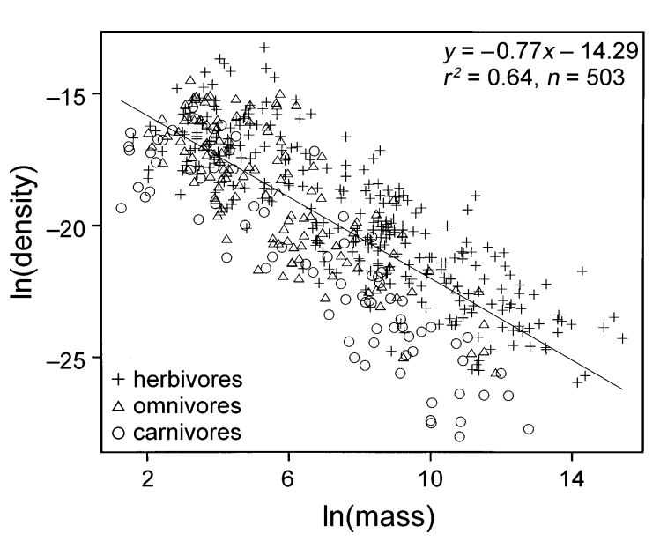
Also, some processes do not change with scales
E.g., fractals (self-similarity across different scales) and metabolic constraints
https://commons.wikimedia.org/wiki/File:Verhulst-Mandelbrot-Bifurcation.jpg
Brown et al. (2004) https://www.esa.org/history/Awards/papers/Brown_JH_MA.pdf
Halley et al. (2004) https://pdodds.w3.uvm.edu/files/papers/others/everything/halley2004a.pdf

Slide 27
Scales as a mediator of contrasting perspectives

Slide 28
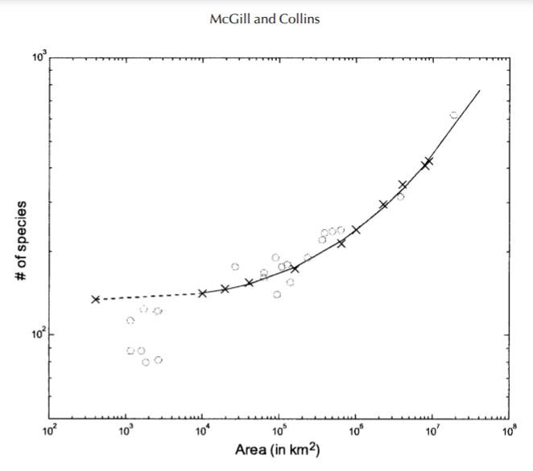
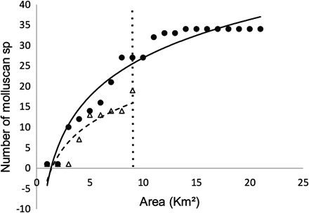
Species-area relationship
Pruden and Leighton (2018) https://link.springer.com/chapter/10.1007/978-3-319-73795-9_7
McGill and Collins (2003) https://citeseerx.ist.psu.edu/viewdoc/download?doi=10.1.1.499.9375&rep=rep1&type=pdf

Slide 29
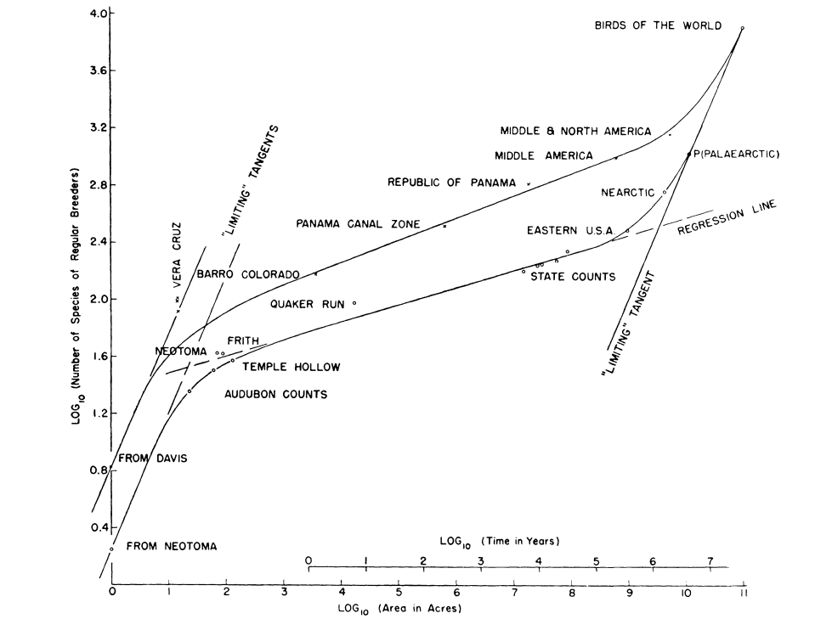
P << R
P ~ R
P >> R
Spatial scale: the relationship between plot size (P) and the range of species (R) mediates this relationship
FYI https://www.youtube.com/watch?v=YfbKYKPUzdo
Preston (1960) https://www.jstor.org/stable/1931793

Slide 30
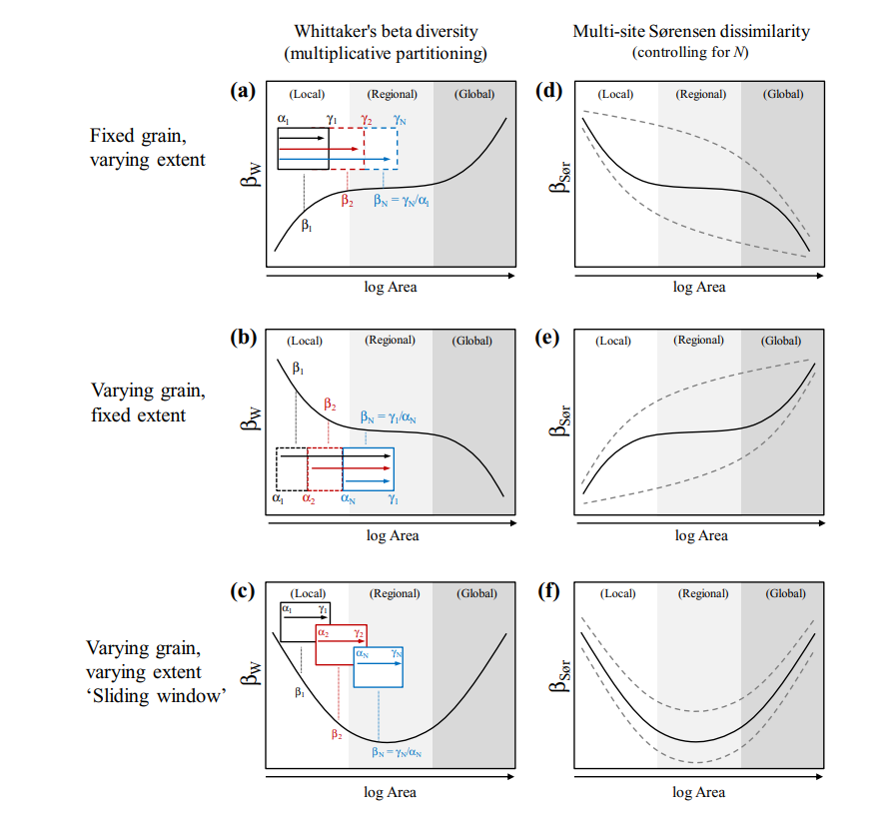
Beta diversity (alpha*beta = gamma)
Barton et al. (2013) https://onlinelibrary.wiley.com/doi/pdfdirect/10.1111/geb.12031

Slide 31
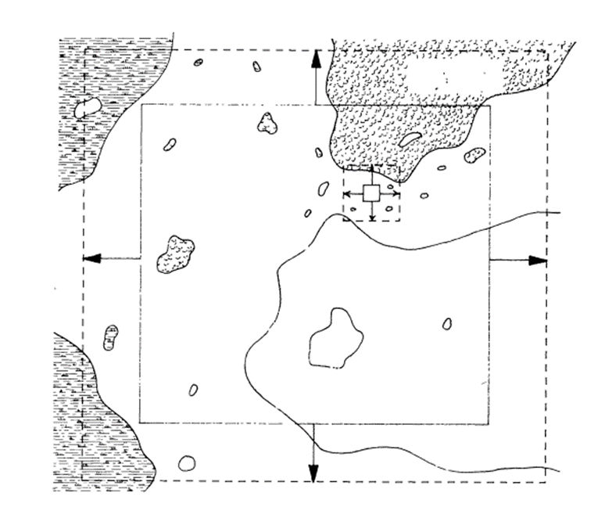
Wiens 1989 – grain vs extent
Barton et al. (2013) https://onlinelibrary.wiley.com/doi/pdfdirect/10.1111/geb.12031

Slide 32
Trends in biodiversity change in time

Slide 33
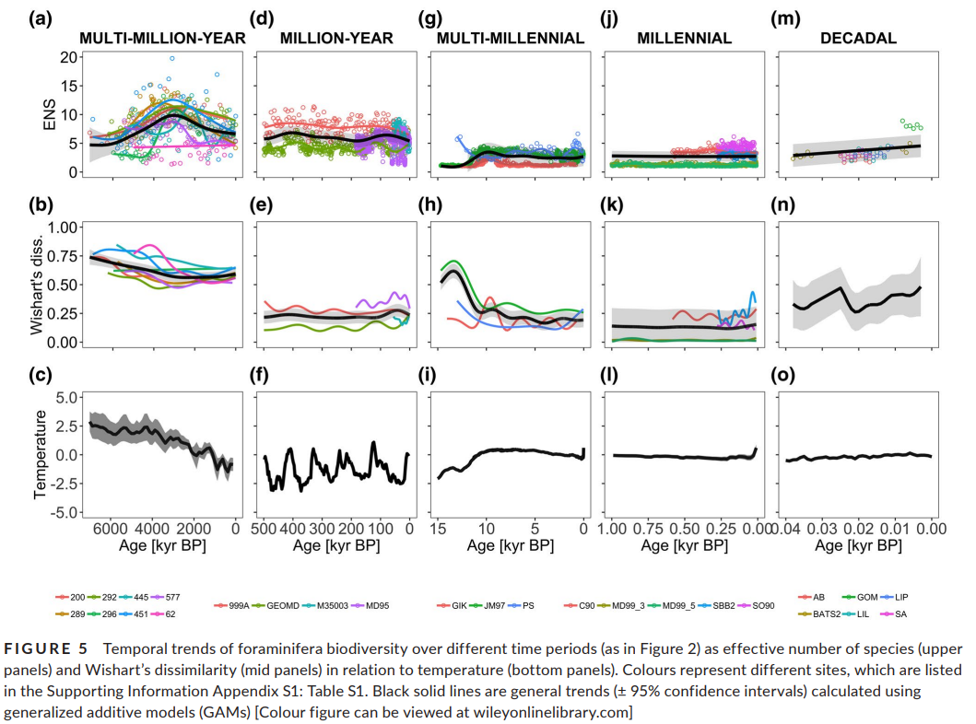
Lewandowska et al. (2020) https://onlinelibrary.wiley.com/doi/pdf/10.1111/geb.13078

Slide 34
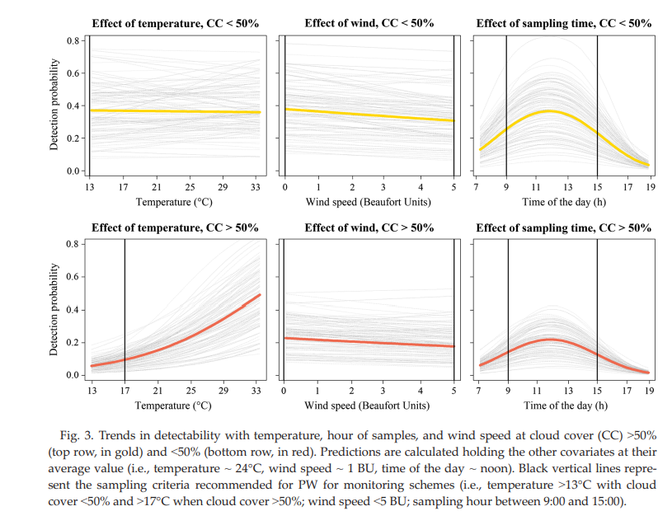
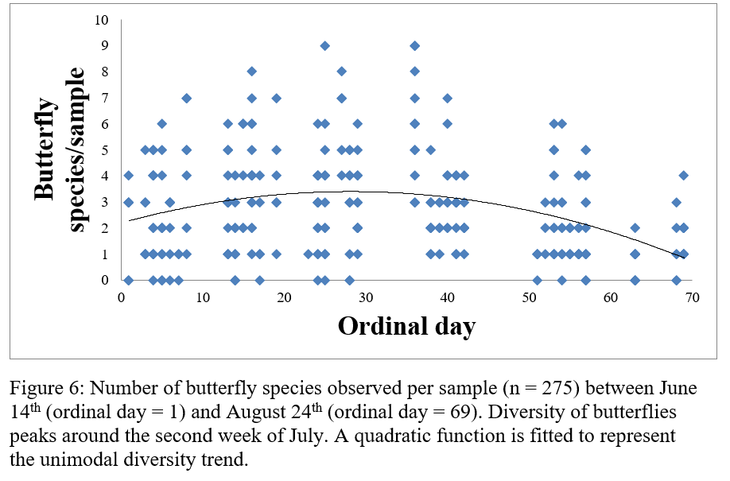
Temporal trends in diversity, abundance, and detectability
Riva et al. (2018) https://www.ace-lab.ca/assets_b/Riva%20et%20al.%20%282018%29%20Biological%20Conservation.pdf
Riva et al. (2020) https://esajournals.onlinelibrary.wiley.com/doi/pdf/10.1002/ecs2.3101

Slide 35
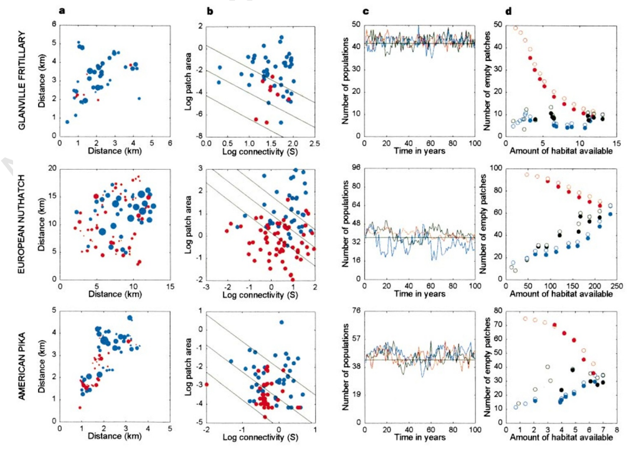
Metacommunity dynamics
Hanski (2002) https://www.nature.com/articles/23876.pdf

Slide 36
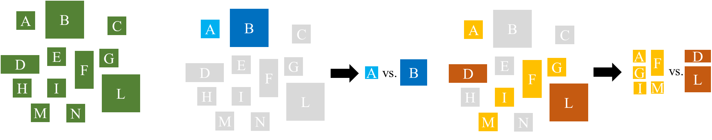
Extinction risk and patch size across spatial scales
Landscape scale
Patch scale
Riva and Fahrig in review

Slide 37
Landscape scale
Patch scale
Riva and Fahrig in review

Slide 38
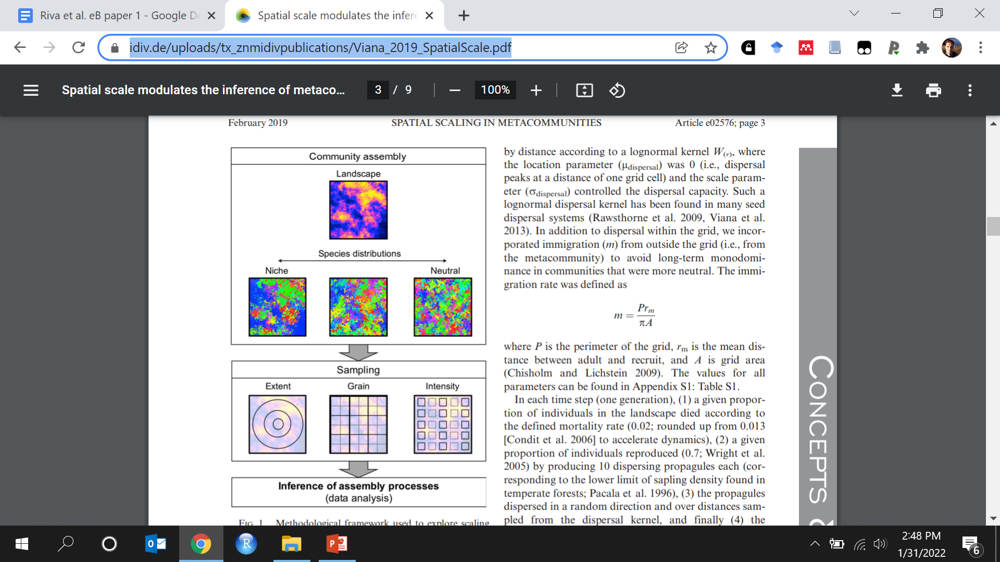
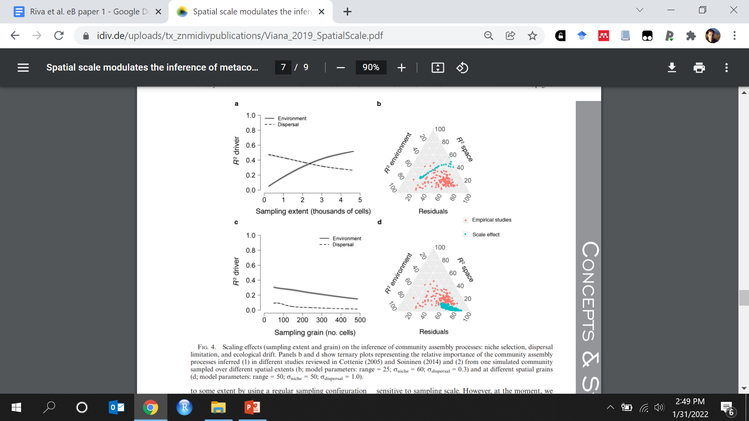
Assembly processes in metacommunities
Viana and Chase (2019) https://www.idiv.de/uploads/tx_znmidivpublications/Viana_2019_SpatialScale.pdf

Slide 39
Scales explain different results observed when answering the same questions in different systems

Slide 40
Applications in ecology and conservation

Slide 41
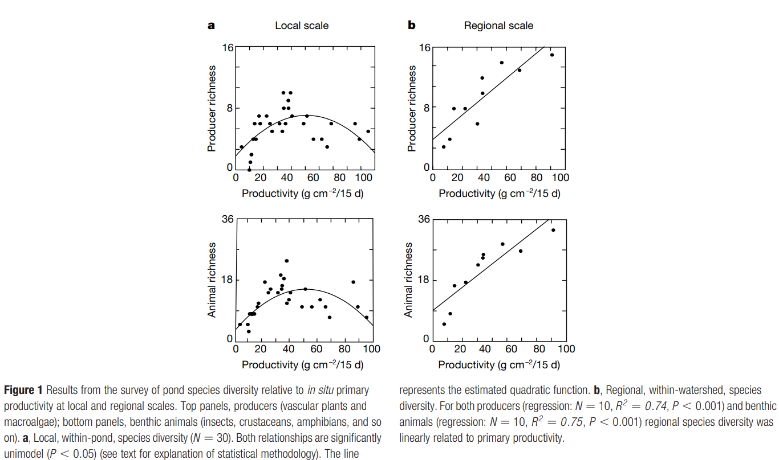
Productivity-diversity relationship
Chase and Liebold (2004) https://www.nature.com/articles/416427a.pdf

Slide 42
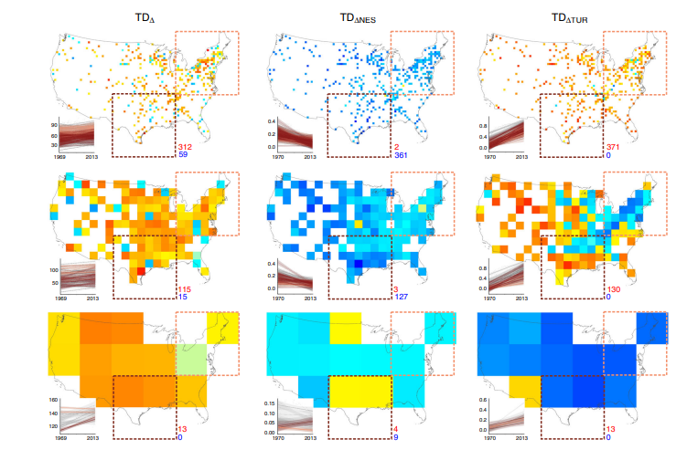
Trends in biodiversity change with spatial scales
… Scales shown, from top to bottom, are 50 km, 200 km, 800 km. Fitted positive and negative slopes indicate increases and declines in taxonomic diversity (TDΔ, left panel), temporal nestedness of taxonomic diversity (TDΔNES, middle panel), and temporal turnover of taxonomic diversity (TDΔTUR, right panel). Red and blue numbers indicate the number of grid cells for which these trends were positive and negative, respectively. Insets show the fitted slopes between the respective measure of change (y-axis) and time (x-axis; calendar year) for the cell inside the brown (brown lines) or beige (beige lines) quadratic regions.
Jarzyna and Jetz (2018) https://www.nature.com/articles/s41467-018-04889-z.pdf

Slide 43
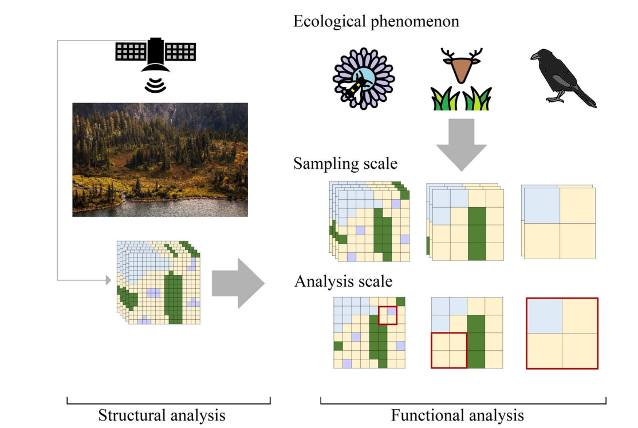
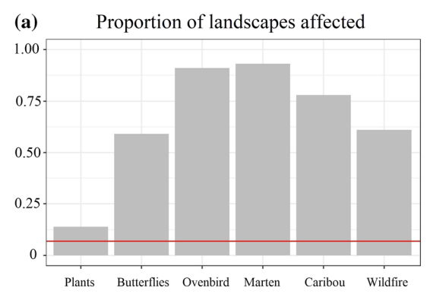
Thematic resolution affects habitat loss measures
Riva and Nielsen (2021) https://ace-lab.ca/assets_b/Riva-Nielsen2021_Article_AFunctionalPerspectiveOnTheAna.pdf

Slide 44
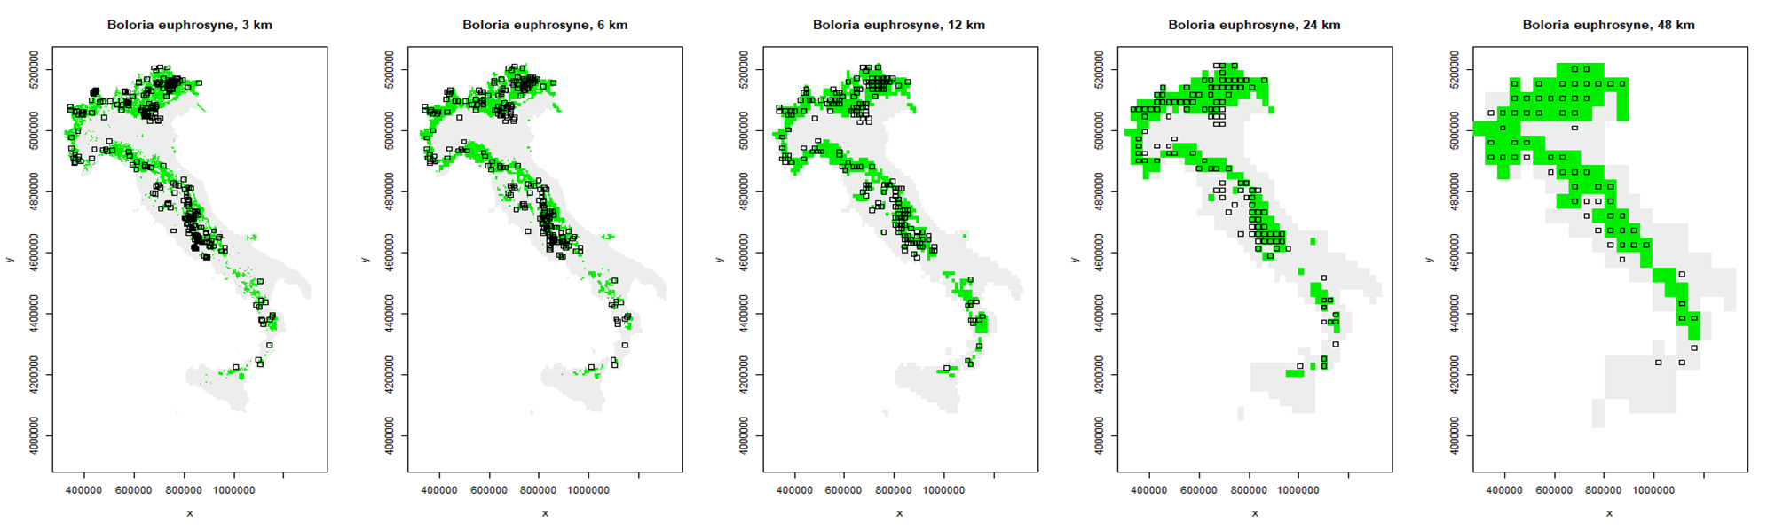
Grain affects the relationship between species distribution and the environment
Riva et al. in preparatiom

Slide 45
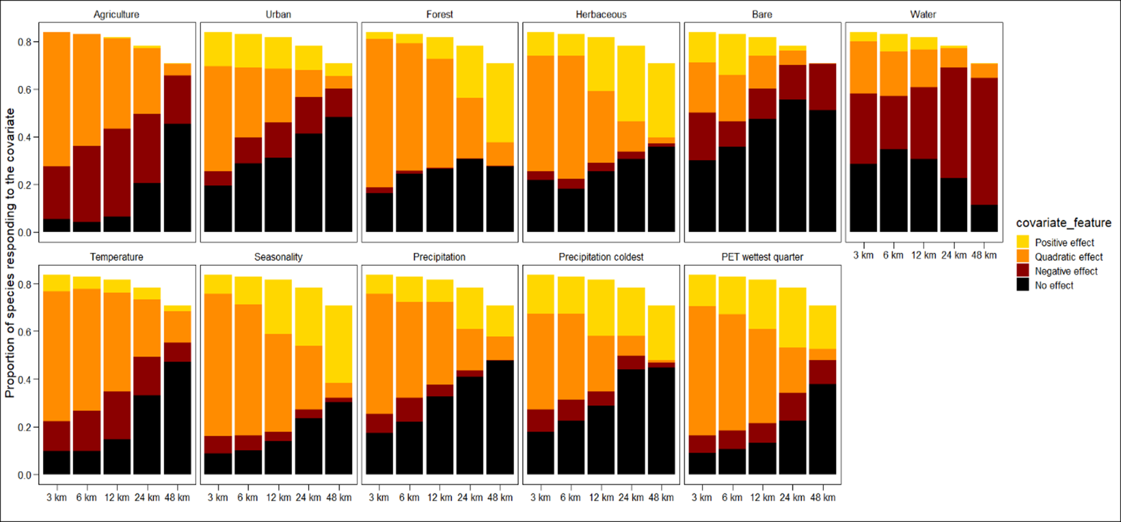
Riva et al. in preparatiom

Slide 46
Conclusions

Slide 47
It does matter – what can we do?
Always think about the ecological process of interest
E.g., for conservation, are you interested in large scale, regional patterns, or in in situ protection and management of species?
Why are you proposing an analysis at a given spatial scale, temporal scale?
Taxonomic scales, other scales?
How can scales affect your conclusion, and why do you think that is?
Are you interested in processes that are typically dynamics, or less so?
Scaling itself remains a topic of interest after 50+ years

Slide 48
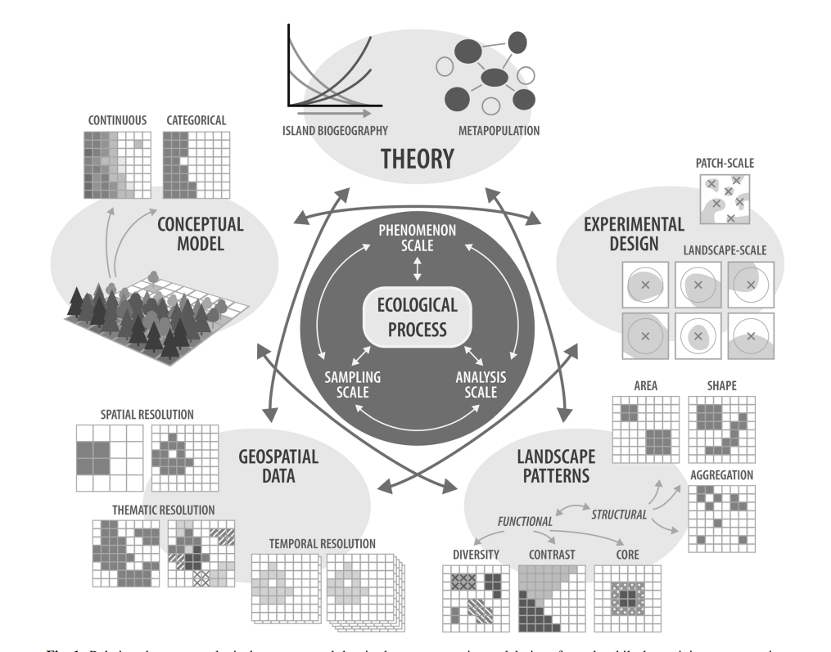
Riva and Nielsen (2020) https://ace-lab.ca/assets_b/Riva-Nielsen2020_Article_SixKeyStepsForFunctionalLandsc.pdf

Slide 49
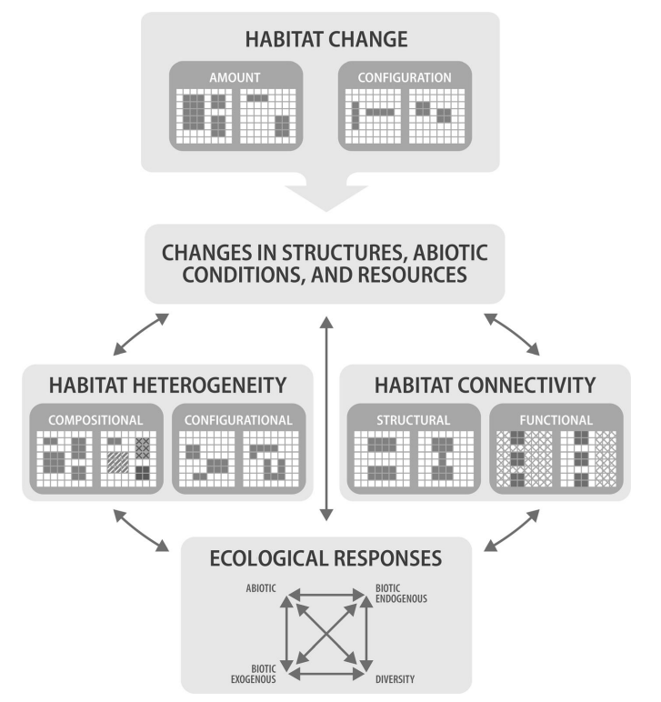
Riva and Nielsen (2020) https://ace-lab.ca/assets_b/Riva-Nielsen2020_Article_SixKeyStepsForFunctionalLandsc.pdf

